Slide 1
Agriculture-Part II
Agriculture Models and Modern Commercial Agriculture

Slide 2
Economic Issues of Agriculture
Challenges for commercial farmers
Overproduction
Sustainable agriculture
Challenges for subsistence farmers
Population growth
International trade
Increasing food supply
Oceans
High Protein Cereals
Improved Palatability

Slide 3
Strategies to increase the food supply in LDCs
Expand current agricultural land
Use of Green Revolution technology in LDCs
Increase agricultural productivity
LDC farmers can’t afford tractors, irrigation pumps or fuel
Identify new food sources
Cultivate the oceans for new fish
Improve food taste for rarely consumed foods (soybean tofu, sprouts or krill)
Increase exports from other countries

Slide 4
Problems in expanding farm land
Lack of water (desertification) because of overgrazing, deforestation or agricultural use
Excessive water (waterlogging) because of irrigated land had inadequate drainage
Urbanization

Slide 5
Commodity chains

Slide 8
Von Thünen Model
A Model of Agricultural Land Use
The Von Thunen model of agricultural land use was created by farmer and amateur economist J.H. Von Thunen (1783-1850) in 1826
The Model is based on two primary costs
The cost of land vs. the distance of reaching your target market.
Next a formula for determining profit is created.
The value of a yield per hectare of land vs. the true cost to transport it market.
Example:

Slide 9
Von Thünen Model’s 4 Rings
There are four rings of agricultural activity surrounding the city. Dairying and intensive farming occur in the ring closest to the city. Since vegetables, fruit, milk and other dairy products must get to market quickly, they would be produced close to the city (remember, we didn't have refrigerated oxcarts!)
Timber and firewood would be produced for fuel and building materials in the second zone. Before industrialization (and coal power), wood was a very important fuel for heating and cooking. Wood is very heavy and difficult to transport so it is located as close to the city as possible.
The third zone consists of extensive fields crops such as grains for bread. Since grains last longer than dairy products and are much lighter than fuel, reducing transport costs, they can be located further from the city.
Ranching is located in the final ring surrounding the central city. Animals can be raised far from the city because they are self-transporting. Animals can walk to the central city for sale or for butchering.
Beyond the fourth ring lies the unoccupied wilderness, which is too great a distance from the central city for any type of agricultural product.

Slide 10
Von Thünen Model
Fig. 10-13: Von Thünen’s model shows how distance from a city or market affects the choice of agricultural activity in (a) a uniform landscape and (b) one with a river.

Slide 11
Simplified von Thünen model of agricultural land use
urban market
high transportation cost items:
vegetables, eggs, dairy
low transportation cost items:
forestry, wheat
(pp. 225-226)
Notes:
DISCUSSION:
* Von Thünen developed his model in 1826. Is it still relevant today?
* Are transportation costs still an important factor in where certain products are raised today?

Slide 12
Things to consider about Von Thunen’s Model
Von Thunen's model was created before industrialization and is based on the following limiting assumptions:
The city is located centrally within an "Isolated State" which is self sufficient and has no external influences.
The Isolated State is surrounded by an unoccupied wilderness.
The land of the State is completely flat and has no rivers or mountains to interrupt the terrain.
The soil quality and climate are consistent throughout the State.
Farmers in the Isolated State transport their own goods to market via oxcart, across land, directly to the central city. Therefore, there are no roads.
Farmers act to maximize profits.

Slide 13
VonThunen applied to the U.S.

Slide 14
Application of Von Thünen Model
Chinese village
Land improvement (by adding organic material) close to village
Land degradation (lots of pesticides and fewer conservation tactics) farther from village
Wealthy countries
Underlying principles on larger scale
Use of faster, higher capacity transportation

Slide 15
Boserup’s 5 stages of intensification
Boserup identified the theory that, as population increases, the food supply is adapted by farmers to meet the changing population (subsistence farmers increase the food supply through intensification of production)
Her first proposal goes through 5 stages of intensification.
Forest fallow – 2 years farmed, 20 years fallow to regrow forest
Bush fallow – 8 years farmed, 10 years fallow to regrow small trees
Short fallow – 2 years farmed, 2 years fallow to regrow grasses
Annual cropping – Once a year farmed
Multicropping – Several times a year, fields are never left fallow
The second manner in which production is increased is through the adoption of new farming methods and basic technology

Slide 16
U.S. Government Policies
Farmers are encouraged to avoid producing crops that are in excess supply
Planting fallow crops that restore nutrients to the soil and help hold the soil
Pays farmers when the difference between the market price and the target price
Government buys surplus foods and sells or donates it to foreign government

Slide 17
Grain Importers & Exporters
Fig. 10-15: Most countries are net importers of grain. The U.S. is the largest net exporter.

Slide 18
World Importing and Exporting
Top Grain Exporters
Top Grain Importers
S and SE Asia
Thailand-esp. rice
India
Vietnam and Pakistan
U.S.-3rd total, but #1 in wheat exports
SW Africa and N. Africa
Saudi Arabia
Sub-Saharan Africa

Slide 19
Undernourished Proportion
Fig. 10-16: The proportion of under-nourished population has declined in most LDCs, but is much higher in sub-Saharan Africa than in other areas of the world.

Slide 20
Caloric intake
most of world’s people have an adequate supply of calories
the five concentrations have a calorie supply called well above adequate -120%
outside of Africa only Haiti and Afghanistan show serious malnutrition
many states in central and east Africa show malnutrition

Slide 21
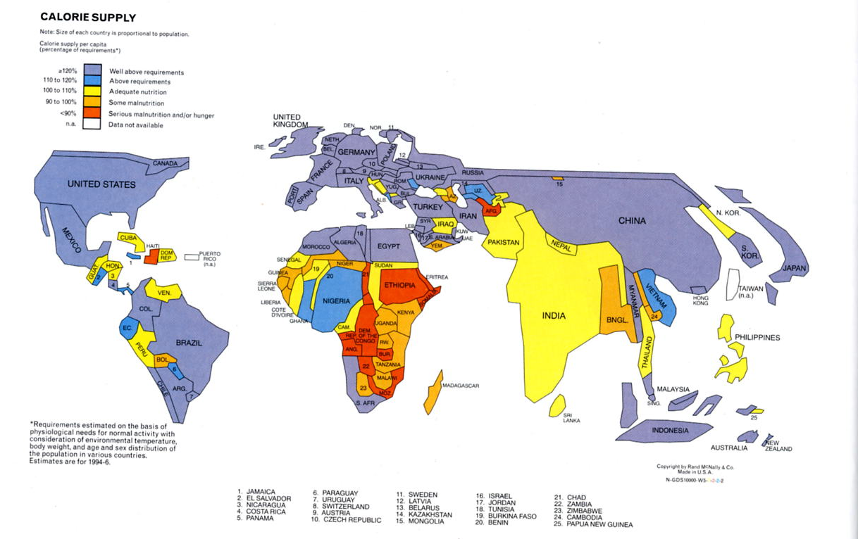

Slide 22
Third Agriculture Revolution (Green Revolution)
Began in U.S. Midwest, then applied to less wealthy countries
Invention of high-yield grains, especially rice, with goal of reducing hunger
Increased production of rice
New varieties of wheat and corn
Reduced famines due to crop failure
Most famines today due to political problems
Impact (in terms of hunger) greatest where rice is produced

Slide 23
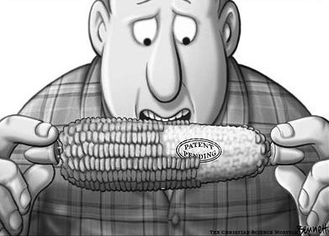
Opposition to Green Revolution
Vulnerability to pests
Soil erosion
Water shortages
Micronutrient deficiencies
Dependency on chemicals for production
Loss of control over seeds
Genetically modified (GM) crops

Slide 24
Genetically Modified Organisms (GMOs)
Pros of GMOs
Cons of GMOs
Longer shelf life
Lower calories/sat. fats
Use fewer pesticides, herbicides & fertilizers
Add vitamins & minerals
Reduces land degradation, enables use of no-till agric.
Increases yield 5-8%
Could feed expanding pop.
Could introduce new allergens
Hurts small farmers
Expensive for poor LDC farms
Furthers our reliance on monocultures
Could harm wildlife
Predicting evolution of super weeds

Slide 25
Genetically Engineered Crops
U.S. farmers have rapidly adopted genetically engineered (GE) soybeans, cotton, and corn with herbicide tolerance (HT) and/or insect resistance (Bt) traits over the 12-year period following commercial introduction
Round-Up Ready (GM seeds) Seeds survive herbicides and insecticides, but weeds become resistant, it contributes to bad soil and water quality

Slide 26
Industrial crops best suited to GE
In the U.S., adoption of HT soybeans has expanded faster and more widely than that of other GE crops, reaching 91 percent of soybean acreage in 2007.
The second most widely adopted GE crop, HT cotton, was planted on 70 percent of cotton acreage.
80% of U.S. soybeans, 54% of cotton, and 12% of corn

Slide 27
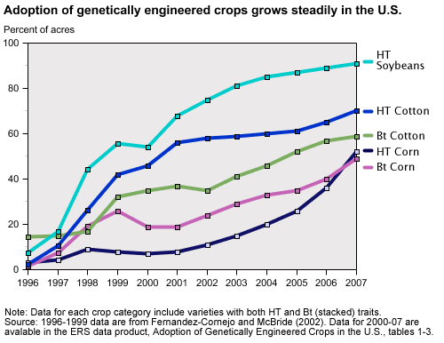

Slide 28
Worldwide impact
More than 250 million acres of biotech crops with HT and/or Bt traits were planted in 22 countries in 2006,
U.S. accounting for about 54 percent
Argentina, Brazil, Canada, India, China, Paraguay, and South Africa together accounting for nearly 43 percent.

Slide 29
Genetically Modified Foods
Genetically modified foods must be labeled in Europe but not in the U.S.

Slide 30
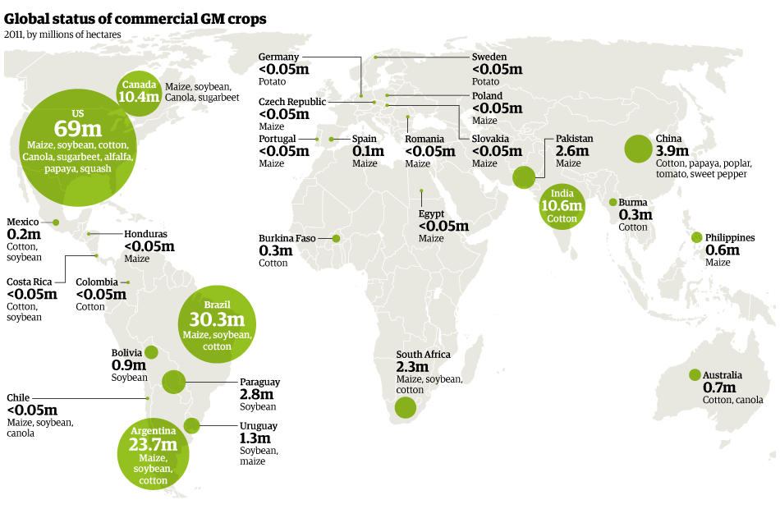

Slide 31
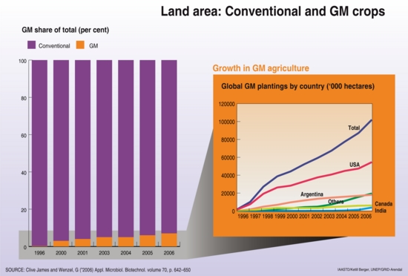

Slide 32
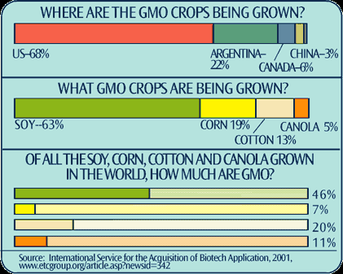

Slide 33
Green Revolution
The term "Green Revolution" was first used in 1968 by former USAID director William Gaud, who noted the spread of the new technologies
Stems from two basic principals
Introduction of new higher yield seeds
Expanded use of fertilizers
Because of the Green Revolution, agricultural productivity at a global scale has increased faster than population growth.

Slide 34
Green Revolution Experiments
Scientists at the International Rice Research Institute try to develop improved crop varieties.

Slide 35
Organic Agriculture
Organic farming has been one of the fastest growing segments of U.S. agriculture for over a decade.
The U.S. had under a million acres of certified organic farmland when Congress passed the Organic Foods Production Act of 1990.
By the time USDA implemented national organic standards in 2002, certified organic farmland had doubled, and doubled again between 2002 and 2005. Organic livestock sectors have grown even faster.

Slide 36
Putting the Green Revolution on Trial Agricultural production and consumption has significantly changed since the 3rd Agricultural Revolution. In groups, identify at least 3 arguments that the major stakeholders in the GMO farming industry have for its expansion or regulation.
Stakeholders:
U.S. Government & other Core countries (Major exporter)
Monsanto (Producer of Ready Roundup GMO Seeds)
Environmentalists
Chinese Government & other Semi-periphery countries (Major importer)
Small U.S. farmer
Large U.S. producers

Slide 37
Rapid growth on small base
While adoption of organic farming systems showed strong gains between 1992 and 2005 and the adoption rate remains high, the overall adoption level is still low—only about 0.5 percent of all U.S. cropland and 0.5 percent of all U.S. pasture was certified organic in 2005..

Slide 38
Organic Farms in the U.S.
California remains the leading State in certified organic cropland, with over 220,000 acres, mostly for fruit and vegetable production.
Other top states for certified organic cropland include North Dakota, Montana, Minnesota, Wisconsin, Texas, and Idaho.

Slide 39
Many U.S. producers are embracing organic farming
to lower input costs,
conserve nonrenewable resources,
capture high-value markets,
boost farm income

Slide 40
Organic Farm in Washington
There is limited use of chemicals and heavy machinery on organic farms such as this one in Whatcom County, Washington state.

Slide 41
Sustainable Agriculture
Sustainable agriculture refers to the long-term ability of a farm to produce food without irreversibly damaging ecosystem health
Principle practices of sustainable agriculture:
Sensitive land management
Limited use of chemicals
Better integration of crops and livestock
Less money is spent on inputs like irrigation water and fertilizers and the product is more valued and higher priced
Organic farming is a form of sustainable agriculture

Slide 42
What are Sustainable Farms?
Involve More:
Involves less:
High yield polyculture
Organic fertilizers
Biological pest control
Irrigation efficiency
Perennial crops
Crop rotation
Soil conservation
Subsidising of sustainable farm practices
Soil erosion
Aquifer depletion
Overgrazing and overfishing
Food waste
Population growth

Slide 43
The impact of farming
Industrial Intensive Agric.
Sustainable Agriculture
Yields increased 3-4 times after WWII when monoculture (single crop) became typical
Fertilizer use is increasing resulting in further decline in soil and water quality (groundwater polluted)
Organic farming relies on mixed crop and livestock farming and crop management
Uses crop rotation and intercropping (2 or more crops are grown at the same time in the same plot
Less pesticides in the environment and food chain
Conservation tillage (ploughing crop residues into the topsoil)

Slide 44
Desertification Hazard
Fig. 10-14: The most severe desertification hazard is in several parts of semiarid Africa, and parts southwestern Asia, North and South America, and Australia.

Slide 45
Name That Key Term

Slide 46
The collecting of roots, seeds, fruit, and fiber from wild plants and the hunting and fishing of wild animals.
Hunting and
Gathering
The intentional cultivation of crops and raising of livestock.
Agriculture
An industrialized, corporate form of agriculture organized into integrated networks of agricultural inputs and outputs controlled by a small number of large corporations.
Agribusiness
Output per unit land per unit time (e.g., tons per acre per year).
Yield
Large-area farms or ranches with low inputs of labor per acre and low output per acre.
Extensive Agriculture

Slide 47
Small-area farms and ranches with high inputs of labor per acre and high output per acre.
Intensive Agriculture
Agriculture in which a large amount of human work is applied per unit of output.
Labor-Intensive
Agriculture
Agriculture in which a large amount of capital is applied per unit of output.
Capital-Intensive
Agriculture
Goods such as equipment and buildings used to produce other goods.
Capital
Agriculture that takes place in the immediate surroundings of a permanent settlement.
Sedentary
Agriculture
A large estate that produces a single cash crop. Mainly found now in the tropics.
Plantation

Slide 48
Artificial watering of farmland.
Irrigation
The original invention of farming and domestication of livestock 8,000–14,000 years ago and the subsequent dispersal of these methods from the source regions.
First Agricultural
Revolution
A period of technological change from the 1600s to mid-1900s that started in Western Europe, beginning with preindustrial improvements such as crop rotation and better horse collars, and concluding with industrial innovations to replace human labor with machines and to supplement natural fertilizers and pesticides with chemical ones.
Second
Agricultural
Revolution
The application of biological science to the development of better strains of plants and animals for increasing agricultural yields.
Green Revolution
also known as the
Third Agricultural Revolution

Slide 49
Agriculture primarily for the purpose of selling the products for money.
Commercial Agriculture
Agriculture that uses a large area of land for production of a single crop year after year.
Monoculture
A farming method in tropical areas in which wild vegetation is cleared and burned before crops are planted. When the soil fertility is diminished, farmers abandon the land to restore itself naturally, and they move to new areas where they repeat the process. Also known as slash-and-burn agriculture.
Shifting
Cultivation
Self-sufficient agriculture, usually small scale and low tech, primarily for direct consumption by the local population.
Subsistence
Agriculture

Slide 50
The general class of material or vegetation that dominates the surface of the land in a particular area.
Land Cover
The general class of activity for which land is used by humans in a particular area.
Land Use
The use of satellite images of the earth’s surface.
Remote Sensing
An integrated agricultural system in which crops are grown and fed to livestock.
Mixed Farming
Domesticated animals such as cows, sheep, and poultry that are raised and managed to produce meat, milk, eggs, wool, leather, etc.
Livestock

Slide 51
Migratory movement of herders and their animals according to the availability of grazing land.
Nomadism
The increasing economic, cultural, demographic, political, and environmental interdependence
of different places around the world.
Globalism
A measure of how much distance discourages movement between places, based on the time, energy, or dollar cost that must be expended.
Friction of
Distance
Imports and exports between countries that are unrestricted by tariffs, quotas, or excessive approvals and paperwork.
Free Trade

