Slide 1
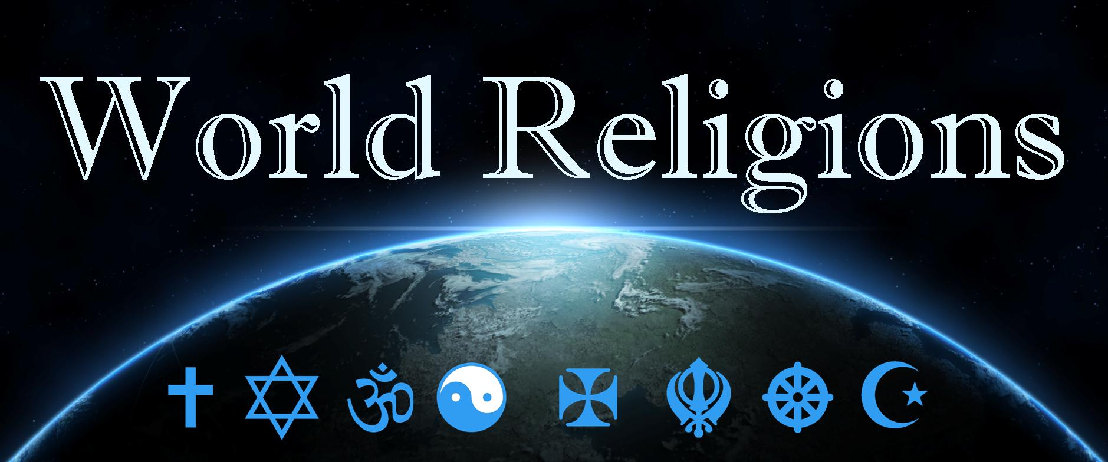
Religion review
Ch. 7

Slide 2
Religion Big Ideas
Religion
Role in society
Secularism
Monotheistic, Polytheistic, Animistic
Diffusion of Religions
Major World Religions
Hearths of religion
S Asia
China
Eastern Mediterranean
Religious landscapes
Religious Conflicts

Slide 3
What is Religion?
According to geographers, Robert Stoddard &Carolyn Prorak, religion is “a system of beliefs & practices that attempts to order life in terms of culturally perceived ultimate priorities.
“Should” people explain & how they & others “should” behave based on their religious beliefs.
A binding force in societies, especially those less dominated by technology
Change over time
Have been adopted across cultural barriers & language boundaries.

Slide 4
Role in Society
In some countries, it practically constitutes culture
Religion manifests itself in many different ways
Worship of souls of ancestors in living natural objects.
Belief that certain living persons possess capacities granted by a supernatural power
Belief in a deity or deities
In Western, industrialized, urbanized societies, religion has become subordinate to secular culture & government.
Effect on culture
“good” life has rewards & “bad” behavior risks punishment-controlling individual behavior.
Modes of dress acceptable & foods a person can or cannot eat
Commercial practices
Location & structure of houses.

Slide 5
Secularism
The indifference to or rejection of formal religion
Most secular countries in Europe
2009 Pew Survey - How important is religion in their lives?
13% in France
8% in Sweden
7% in Czech Republic
Even if your society is secular & regardless of your religious beliefs, what you eat, when you work, when you shop, & what you are allowed to do, are all influenced by religion.

Slide 6
Monotheistic, Polytheistic, Animistic
Despite the wide variety of religions found around the world, they are commonly classified into three categories.
Based on their approaches to the concept of divinity
Monotheistic – worship a single deity, a God, or Allah
Polytheistic – worship more than one deity, even thousands
Animistic – centered on the belief that inanimate objects, such as mountains, boulders, rivers, & trees, possess spirits & should be revered.
Throughout much of human history, virtually all religions were either animistic, polytheistic, or both
Approx. 3500 yrs. ago monotheistic religion developed in SW Asia – Zoroastrianism

Slide 7
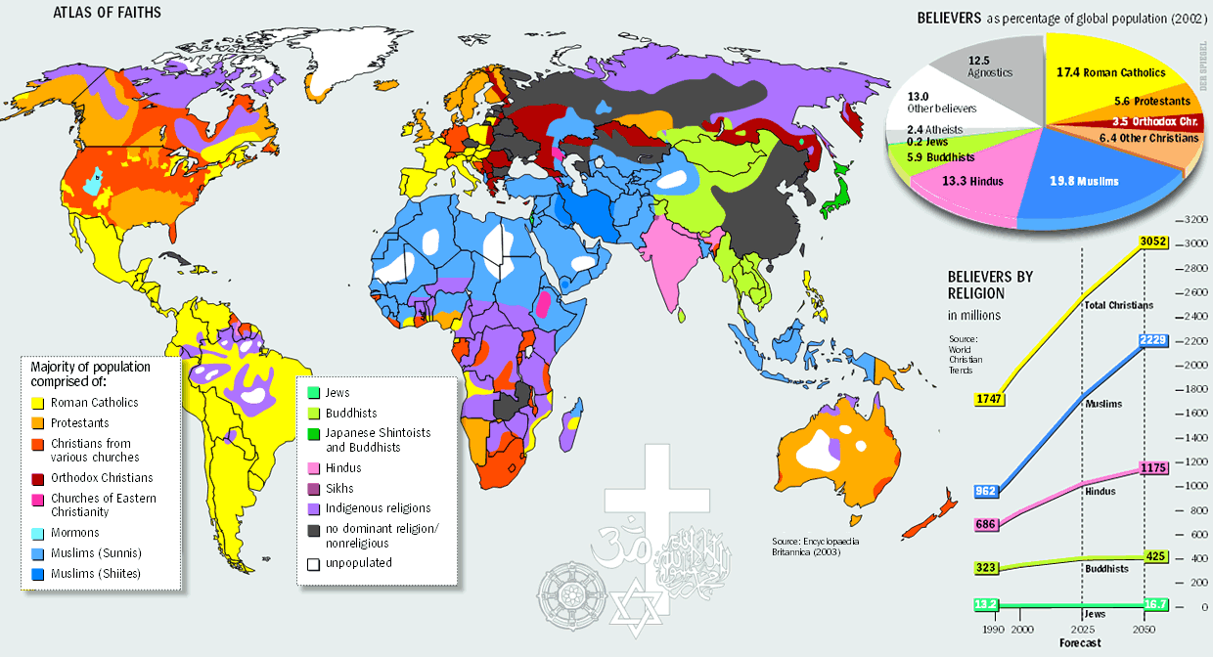

Slide 8
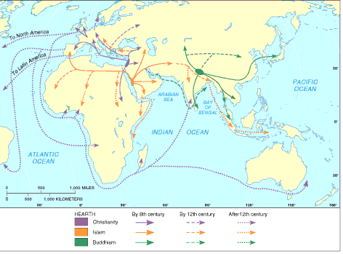
Diffusion of Religions
Religions diffuse through…
Expansion – including both contagious & hierarchical
Relocation
With either of these, leaders or followers interact with people who do not espouse the religion
Sometimes lead to conversion
Spatial interaction occurs because of migration, missionary efforts, & even conquest.

Slide 9
Major World Religions
Any map of world religions is a generalization
Caution must be used when making observations from the map.
Mask minority religions, many of which have a significant number of followers.
Some of the regions shown as belonging to a particular religion are places where faiths have penetrated relatively recently.
Each of the widespread religions share in one characteristic
They are all universalizing
Actively seek converts because they view themselves as offering belief systems of universal appropriateness & appeal.

Slide 10
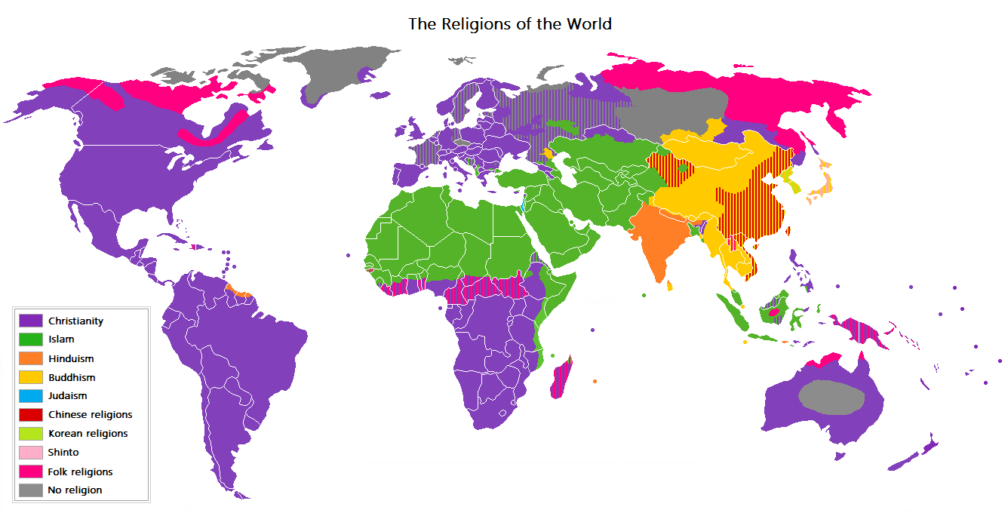

Slide 11
Hearths of Religion
S. Asia

Slide 12
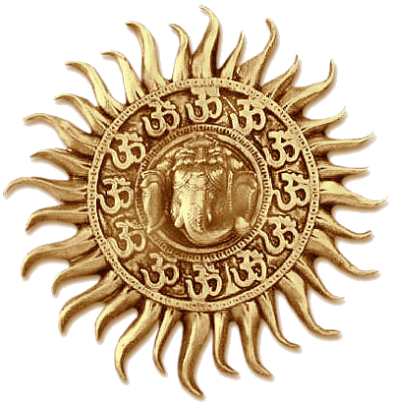
Hinduism
3rd largest after Christianity & Islam
Monotheistic or polytheistic
Ethnic religion – appeals primarily to one group of people living in one place.
Do not actively seek converts
Dates back over 4,000 years
No single founder, theology, or agreement on its origins
Recognize the sacredness of the Vedas - texts that make up the sacred books
Karma
Doctrines are closely tied to Indian society's caste system
Sacred River – Ganges River

Slide 13
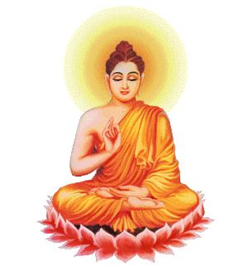
Buddhism
Splintered from Hinduism over 2500 years ago
Reaction to questions about Hinduism’s teachings
Prince Siddhartha – Buddha
Preached salvation could be attained by anyone
Knowledge; elimination of greed, craving, & desire; complete honesty; & never hurting another person or animal
Various branches have an estimated 347 million adherents
Mahayana & Theravada claiming most adherents
Universalizing religion
Nonevangelical

Slide 14
Diffusion of…
Hinduism migrated from present-day Pakistan to the Ganges River.
Diffused throughout S Asia & into SE Asia.
First attached itself to traditional faiths & then slowly replaced them.
Over the last two centuries, through migration
During colonialism, relocation diffusion to British colonies
Buddhism first spread due to Emperor Asoka
Sent missionaries to distant peoples
Spread as far south as Sri Lanka
Later advanced to Mediterranean, Tibet, China, Korea, Japan, Vietnam, & Indonesia over 10 centuries.
Changed as it grew & is strongly regional with different forms.
Has become a global religion

Slide 15
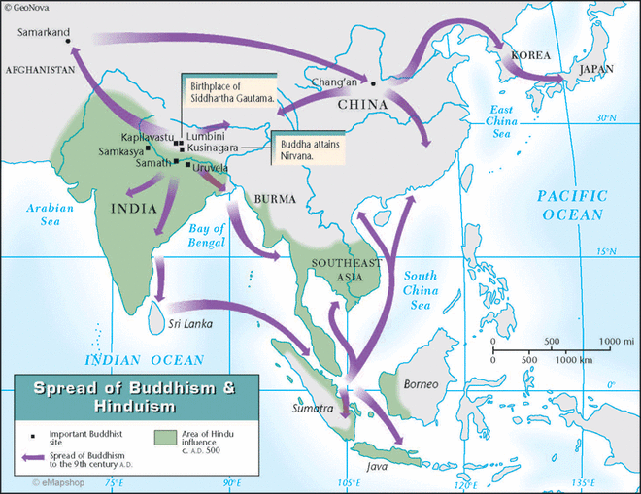

Slide 16
Hearths of Religion
Huang He River Valley

Slide 17
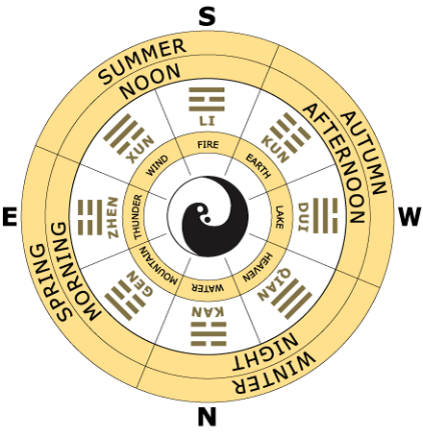
Taoism
Beginnings unclear
Trace the religion to an older contemporary of Confucius, Lao-Tsu
Focused on the proper form of political rule & on the oneness of humanity & nature
Gave rise to the concept of Feng Shui
Nothing should be done to nature without consulting the geomancers
Virtues are simplicity, spontaneity, tenderness, & tranquility
War should be avoided

Slide 18
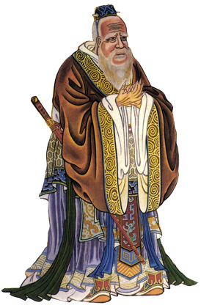
Confucianism
Addressed the traditional Chinese tenets that included belief in heaven & the existence of the soul, ancestor worship, sacrificial rites, & shamanism
Held that the meaning of life lay in the present
Service to one’s fellow humans should supersede service to spirits.
Mainly a philosophy of life
Had great & lasting impacts on Chinese life.
Revered as a spiritual leader after his death

Slide 19
Diffusion of…
Confucianism diffused throughout East & SE Asia
Has long influenced the practice of Buddhism
Diffusion within China has been tempered by government efforts to suppress religion
Both so entrenched in Chinese culture that governments initiative have not had desired effect.
More recently, Chinese immigrants expanded influence in parts of SE Asia, Europe, & N. America.

Slide 20
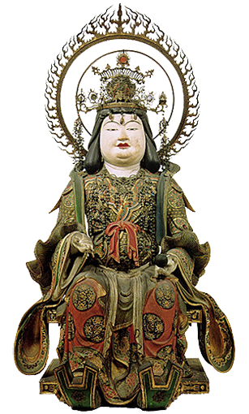
Shintoism
Ethnic religion
Focuses particularly on nature & ancestor worship
Japanese emperor made state religion in 19th century
Animist religion
Mostly found in Japan

Slide 21
Hearths of Religion
Eastern Mediterranean

Slide 22
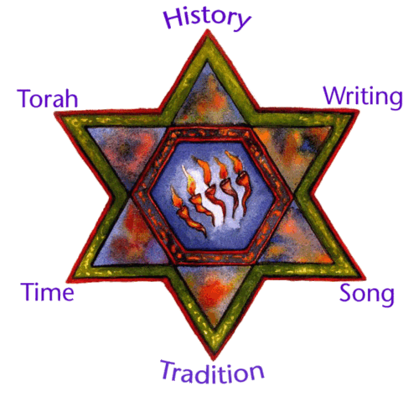
Judaism
Monotheistic
Ethnic
Grew out of the belief system of the Jews about 4000 years ago
Traditions lie in teachings of Abraham
Not limited to contiguous territories
Distributed through parts of Middle East & N. Africa, Russia, Ukraine, Europe, & parts of North & South America
Only country where this religion is the majority is Israel
Three branches
Reform – developed with objective of adjusting Judaism & practices to current times
Orthodox – sought to retain old precepts
Conservative – less strictly orthodox, but not as liberal as reform.

Slide 23
Diffusion of …
Jewish diaspora – scattering of the Jews after Roman destruction of Jerusalem
Now signifies the spatial dispersion of members of any ethnic group
Zionism – idea of a homeland for the Jewish people
Popular during the 19th century
1948
UN created Israel and Palestine
Many Jews have moved to Israel after establishment
2004 – 10,000 left former Soviet Union; 4000 Jews from Africa; over 2000 from western Europe & North America each.
18 million Jews worldwide
40.5% US; 40.2 Israel

Slide 24
Christianity
Traced back to same hearth as Judaism
Stems from a single founder, Jesus
Teachings hold that Jesus was placed on Earth to teach people to live according to God’s plan.
Monotheistic
Universalizing
First split between Roman Catholicism & Eastern Orthodox
Divided for purposes of government
Roman Catholicism claims most adherents (more than 1 billion)
15th & 16th centuries lead to Protestant Reformation

Slide 25
Diffusion of…
Expansion combined with relocation diffusion
Christianity declined in Western Europe after fall of the Roman Empire
Contagious diffusion as religious ideas spread from coastal Ireland & Scotland throughout western Europe
Eastern Orthodox – contagious diffusion from the religion’s hearth in Constantinople to north & northeast.
Protestantism – contagious diffusion in several parts
Hierarchical into northern & central Europe as political leaders converted
Worldwide diffusion occurred during European colonialism
Has always been characterized by aggressive & persistent proselytism
Attempt to convert people to their beliefs.

Slide 26
Islam
Youngest of the major religions
2nd Largest to Christianity
Monotheistic
Traced back to a single founder, Muhammed
Received the truth directly from Allah
Precepts of Islam revised Judaic & Christian beliefs & traditions
One god; earthly matters are profane; Omnipotent and omniscient
5 Pillars of Faith
Two main branches – occurred almost immediate after death
Sunni – great majority
Shi’ite – concentrated in Iran

Slide 27
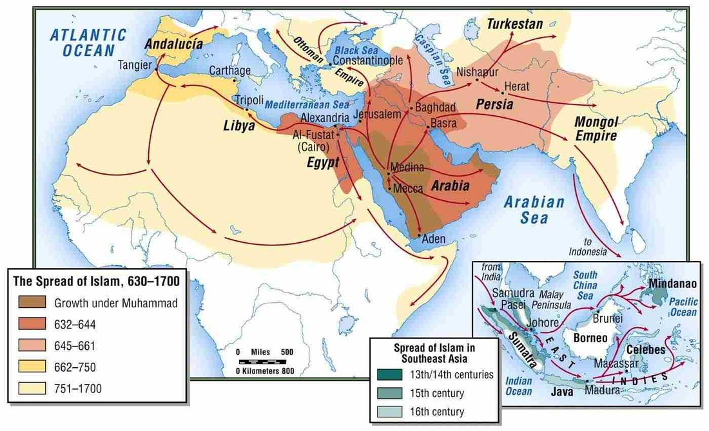
Diffusion of…
Converted Arabian Kings utilized armies to spread faith across Arabian peninsula
Diffused throughout North Africa
Early 9th century included parts of Africa, Europe, Arabia, Middle East, & present-day Pakistan
Through trade, later spread across Indian Ocean
Established new secondary hearths & worked to diffuse contagiously
Recent diffusion into Europe, S. Africa, and the Americas has largely been through migration
Relocation diffusion

Slide 28
Indigenous & Shamanist
Indigenous religions – reverence for nature, passed through family units & groups (tribes) of indigenous people
No central tenet or belief
Grouped because they share the same pressures from diffusion of global religions
Shamanism – community faith in which people follow their shaman (religious leader)
Appeared at various times to various peoples in Africa, Native America, SE Asia, & E Asia
Traditional religion

Slide 29
Religious Landscapes
Marks cultural landscapes with houses of worship, cemeteries, icons, stores for religious goods, sacred sites
Pilgrimage – act of voluntary travel to a religious/sacred site
Sacred Sites
Jerusalem – sacred to Jews, Christians, and Muslims
Hinduism & Buddhism – pilgrimages follow prescribed routes.
Hinduism – temples & shrines are sacred
Buddhism – Bodhi tree
Christianity – medieval churches, cathedrals, or monasteries
Islam – Mosque with towering minarets. Holy Kaaba in the Grand Mosque

Slide 30
Religious Conflicts
Usually involve more than differences in spiritual practices & beliefs
Functions as a symbol of a wider set of cultural & political differences.
Interfaith boundaries – boundaries between the world’s major faiths
Subject to potentially divisive cultural forces – particularly when people see their religious differences as a source of social division in their country
Intrafaith boundaries – boundaries within a single major faith
Include divisions between Christian Protestants & Catholics, Muslim Sunni & Shi'ite

Slide 31
Places of Religious Conflict
Jerusalem – Muslims & Jews
Nigeria – Muslims & Christians
Yugoslavia – Muslims, Eastern Orthodox, & Roman Catholic
Ireland – Protestant & Catholic
Religious Fundamentalism – born out of frustration over the perceived breakdown of society’s mores & values, lack of religious authority, failure to achieve economic goals, etc.
Holds religious beliefs as nonnegotiable & uncompromising.
Religious extremism – fundamentalism carried to the extreme
Christianity
Judaism
Islam

