Slide 1
Global Agricultural Practices
Kester
AP Human

Slide 2
Subsistence Farming
Remains widely practiced in less- developed/periphery countries
It is divided into three parts: shifting cultivation, intensive subsistence agriculture, and pastoralism

Slide 3
Shifting Cultivation
Extensive Subsistence Agriculture: using a large amount of land to cultivate food.
Farmers rotate the fields they cultivate to allow the soil to replenish its nutrients, rather than farming the same plot of land over and over.
It is found in the tropical zones, especially rainforest areas in Africa, Amazon River Basin in South America, and throughout Southeast Asia.

Slide 4
Shifting Cultivation Conti.
Slash and burn agriculture (Milpa): common way that subsistence farmers prepare a new plot of land for farming; land is cleared by cutting and burning the existing vegetation to clear a plot for new farmland (swidden).
Intertillage: practice of mixing many types of seeds on the same plot of land; allows for a balanced diet and reduces the risk of crop failure.

Slide 5
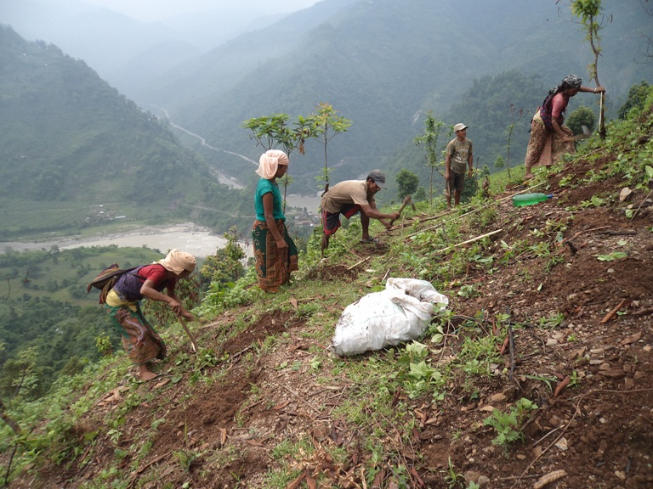
Shifting Cultivation

Slide 6
Intensive Subsistence Agriculture
Farmers cultivate small amounts of land very efficiently to produce food for their families.
Usually found in regions that are highly populated.
Found in China, India, and Southeast Asia.
Terrace farming (pyramids)

Slide 7
Intensive Subsistence Agriculture Conti.
Rice is the dominant crop in South China, India, Southeast Asia, and Bangladesh where summer rainfall in abundant.
In areas with cold weather grains (wheat, corn, millet) are grown.
Double cropping: planting and harvesting a crop on a field more than once a year.

Slide 8
Pastoralism
The breeding and herding of animals to produce food, shelter and clothing.
Located in areas with limited arable land like North Africa, Central and Southern Africa, the Middle East, and Central Asia.
2 types: sedentary and nomadic
Sedentary: pastoralists live in one place and herd their animals in nearby pastures.
Nomadic: pastoralist travel with their herds and do not settle in one place for long.
Transhumance: the movement of animal herds to cooler highland areas in the summer to warmer, lowland areas in the winter.

Slide 9
Subsistence Farming and Colonization
Colonial powers forced subsistence farmers-
To pay taxes, which forced the farmer to sell some of his crops
To use some of their land to grow cash crops like cotton
Remember mercantilism= PROFITS!!!
This forced cropping led to wide spread famine in areas where subsistence farming was dominant

Slide 10
Mediterranean Agriculture
Associate with the region near the Mediterranean Sea and places with climates that have hot, dry summers and mild, wet winters (California, Chile, southern South African, and south Australia)
Farming includes wheat, barely, vine, and tree crops (grapes, figs, olives), and grazing sheep and goats

Slide 11
Commercial Farming
Producing crops to sell in the marketplace
Types of Commercial Farming
Mixed crop and livestock farming
Ranching
Dairying
Large scale grain production
Plantation farming

Slide 12
Mixed crop and livestock Farming
Growing crops and raising livestock
Most of the crops grown go to feed the livestock, which supplies fertilizer as well as goods for sale like eggs and milk
Located in areas of Europe and eastern North America
Practice crop rotation

Slide 13
Ranching
Commercial grazing, or the raising of animals of a plot of land
Cattle and sheep are most common on ranches due to high demand of meat and wool
Practiced in western U.S., Argentina, southern Brazil, and Uruguay (rare in Europe except for Spain and Portugal)

Slide 14
Dairying
Growth of milk-based products for the marketplace
Dairy farms close to the marketplace produce the most perishable fluid milk products
Dairy farms further from the marketplace produce milk goods such as cheese and butter
Practiced in cities in northwestern US, southeastern Canada, northeastern Europe.

Slide 15
Dairying Conti.
Small farms and capital intensive
Capital Intensive farms- use a lot of machinery in the labor process
Improvement in technology and transportation enable famers to locate further from the city’s center, this increasing the milk shed

Slide 16
Large- Scale Grain Production
Extensive commercial grain farm where the grain typically is grown to be exported to other places for consumption
Wheat is the dominant crop
Most common in Canada, the United States, Argentina, Australia, France, England, and Ukraine
US is the largest large-scale grain producing country

Slide 17
Large-Scale Grain Production Conti.
Wheat is the world’s leading export crop and is dominated by the US and Canada
Manny grains farms produce food for animals not humans

Slide 18
Plantation Farming/ Agricultural Estates
Involves large-scale farming operations specializing in one or two high demand crops for export
Introduced to tropical and subtropical zones by European colonizers
Coffee, tea, pineapples, palms, coconuts, rubber, tobacco, sugarcane, and cotton
Most exist in the low-latitude and periphery areas of Africa, Asia, and Latin America

Slide 19
Plantation Farming/ Agricultural Estates Conti.
Owned by corporations or individual from more developed countries
Labor intensive, which requires large numbers of seasonal laborers

