Slide 1
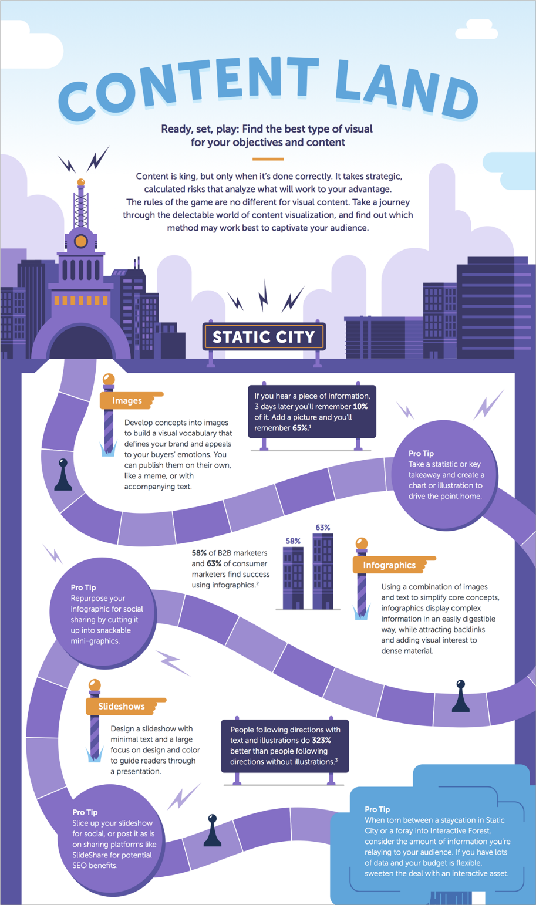
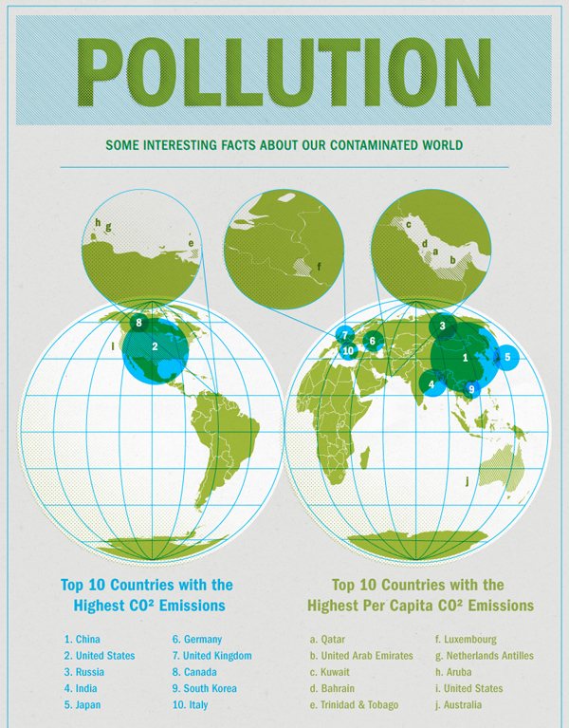

Slide 2
Day 1 Home Learning:
1. Create a chart to better understand College Board Command Words.
2. Take care of the beginning of school syllabus tasks.
The chart should take up an entire page in your new journal; 6 rows, 3 columns.
For each of the 5 command words, define what the word means in one column, then describe what is expected of you in your writing.
All note-taking resources are located on my website for guidance/assistance.
Sign up for Remind.com
Have parent/guardian complete the Google Form Questionnaire
Acquire a composition notebook (journal)
Register on College Board website

Slide 3
Task Verbs Used in Free-Response Questions The following task verbs are commonly used in the free-response questions: Compare: Provide a description or explanation of similarities and/or differences. Define: Provide a specific meaning for a word or concept. Describe: Provide the relevant characteristics of a specified topic. Explain: Provide information about how or why a relationship, process, pattern, position, or outcome occurs, using evidence and/or reasoning. Identify: Indicate or provide information about a specified topic, without elaboration or explanation.
Does knowing this information change the way you will write?
Did any of the descriptions of the words surprise you?
Which word do you think will be the hardest to answer? Easiest?
What’s the biggest difference between describe and explain?

Slide 6
Peer Evaluation Norms: Always use a colored pen (anything other than black or dark blue.)
Expectations (what you should always practice):
Unacceptable (what I will never see you do):
Underline any accurate points that the student clearly made.
Provide any general or content-related feedback (positive or improvements) in the margins or below the response.
“I really liked how you got straight to the point with your explanation.”
“Your definition of gerrymandering really helped me further understand.”
“Try adding an example to support next time.”
Crossing out any information in a student’s response.
Lack ofeeback

