Slide 1
Why do people migrate? Models of Migration
Gravity Model
Lee’s model
Stepped migration

Slide 2
Gravity model
Larger places attract more migrants.
Closer places attract more migrants than more distant places.
WHY?
Notes:
Distance decay, we have more knowledge and interaction with places closer to us

Slide 3
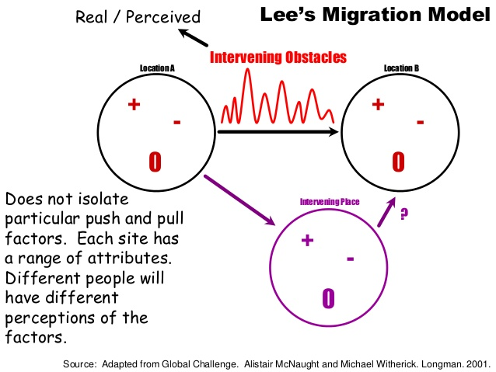
Lee suggests there are 4 classes of factors that influence decision-making:
DESTINATION
Those associated with the place of origin, ex: A severe winter causing a great loss of animal herds leaving people to flee the countryside
Those associated with the place of destination (pull factors)
Intervening obstacles that lie between the places of origin and destination
A variety of personal factors that moderate 1, 2, & 3

Slide 4
Stepped migration/stepwise
Migrant moves up the urban hierarchy through a series of steps – from the small rural village, to a town, then later on to a larger urban settlement.

