Slide 1
Name that boundary (dispute)!
RULES:
You will have 60 seconds to consult with your group, discuss and record your response on the white board.
If the buzzer sounds before your board is up, you will not get credit for the point.
All correct answers will be awarded for each round – not the first board up.
Keep track of your own points on the group’s white board.

Slide 2
This step to establishing a boundary includes creating a visible boundary such as a fence, wall or sign.
DEMARCATE

Slide 3
This step to establishing a boundary includes drawing the boundary onto a map.
DELIMIT

Slide 4
This step to establishing a boundary includes enforcing the boundary that has been created, usually by the government.
ADMINISTRATE

Slide 5
This step to establishing a boundary includes legally describing and negotiating the location of the boundary.
DEFINE

Slide 6
This type of boundary dispute occurs when states do not agree on where the boundary is actually located.
DEFINITIONAL BOUNDARY DISPUTES

Slide 7
This type of boundary dispute occurs when states do not agree on the ownership of a border, usually along mutual borders.
TERRITORIAL/LOCATIONAL BOUNDARY DISPUTES

Slide 8
This type of boundary dispute occurs when states desire natural resources, such as mineral deposits, fertile farmland and water.
ALLOCATIONAL BOUNDARY DISPUTES

Slide 9
This type of boundary dispute occurs when states do not agree on neighboring states cannot agree on policies that apply in a border area.
OPERATIONAL BOUNDARY DISPUTES

Slide 10
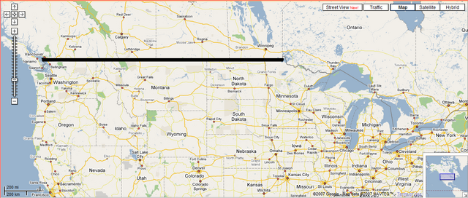
ANTECEDENT BOUNDARY

Slide 11
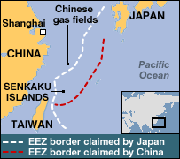
ALLOCATIONAL BOUNDARY DISPUTE

Slide 12
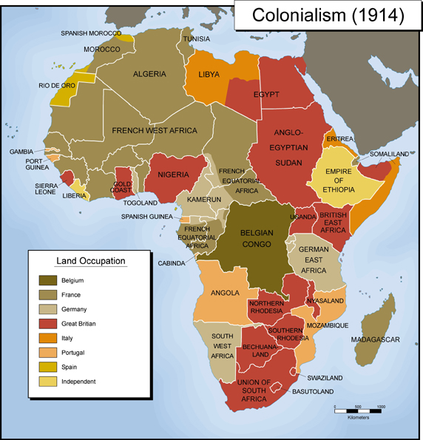
SUPERIMPOSED BOUNDARY

Slide 13
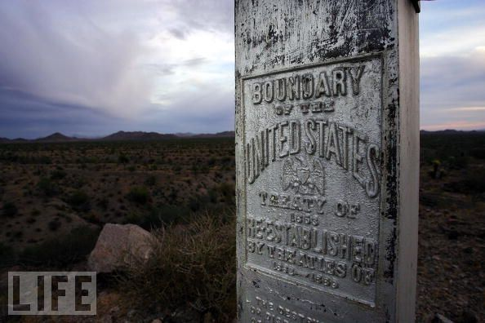
Examples: Immigration or trading
OPERATIONAL BOUNDARY DISPUTE

Slide 14
This step to establishing a boundary includes legally describing and negotiating the location of the boundary.
DEFINE

Slide 15
This step to establishing a boundary includes drawing the boundary onto a map.
DELIMIT

Slide 16
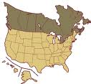
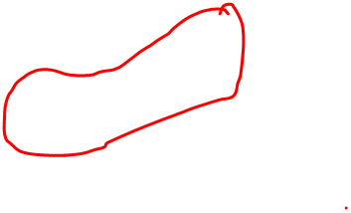
SUBSEQUENT BOUNDARY

Slide 17
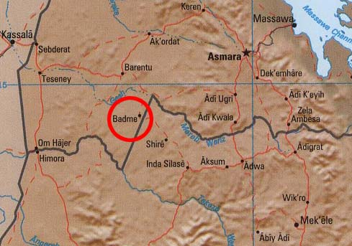
Example: Border was drawn wrong on a map
LOCATIONAL BOUNDARY DISPUTE

Slide 18
This step to establishing a boundary includes creating a visible boundary such as a fence, wall or sign.
DEMARCATE

Slide 19
DEFINITIONAL BOUNDARY DISPUTE

Slide 20
This step to establishing a boundary includes enforcing the boundary that has been created, usually by the government.
ADMINISTRATE

Slide 21
This type of boundary dispute occurs when states do not agree on the ownership of a border, usually along mutual borders.
TERRITORIAL/LOCATIONAL BOUNDARY DISPUTES

