Slide 1
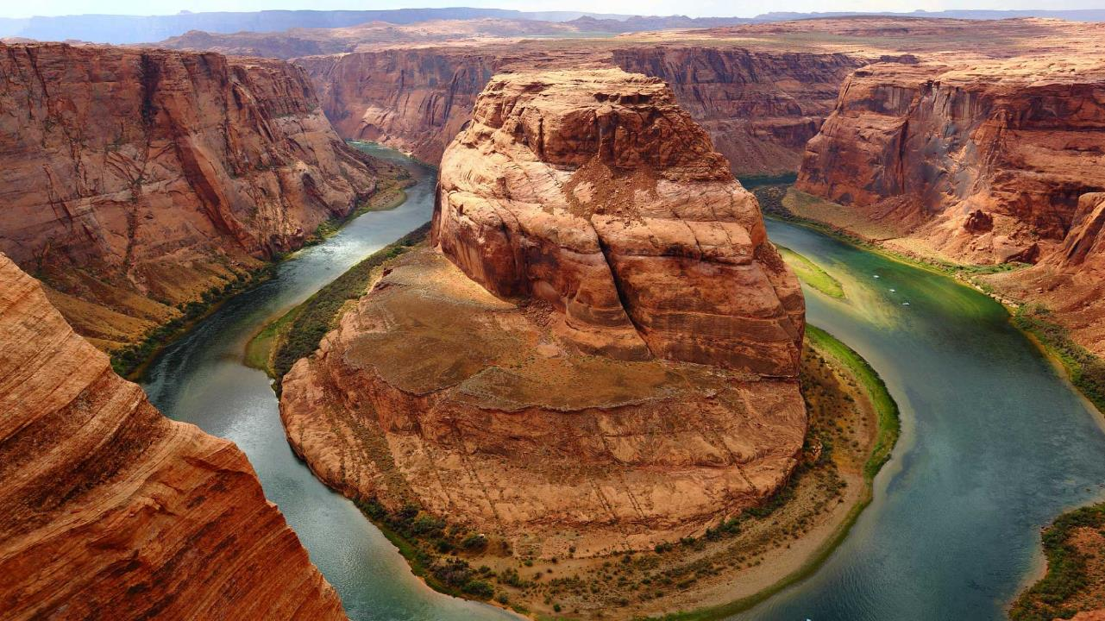
Using Case Studies
N
W
E
S
5 steps to interact and use case studies to support your knowledge of the geographic environment
Notes:
A template for students to design a field trip to a location for other students to view. Includes directions to the student of what to include on each slide and what content should be considered.

Slide 2
Step 1: Choosing an appropriate case study.
Should be real, versus theoretical (and local, if possible)
Dated no earlier than 1980
Assess the relative success or
failure of initiatives:
Example - “Candidates must study one tourist area or resort, its growth and development, showing the issues of sustainability it faces and evaluating the impacts of tourism on the environment, society and economy.”

Slide 3
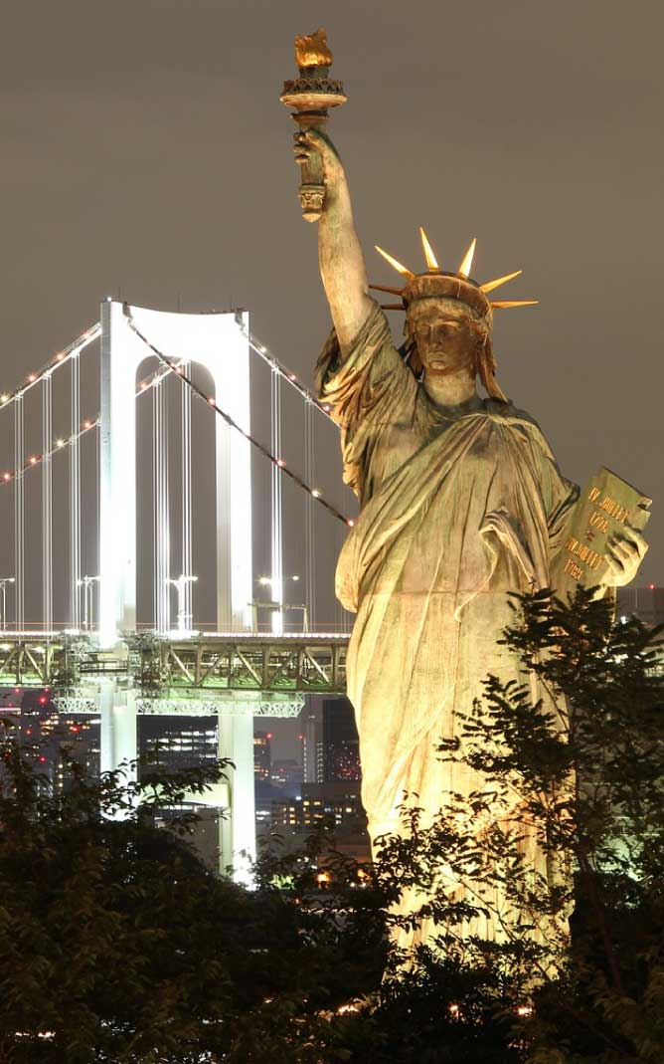
Step 2: Sourcing the information
Useful sources:
International Hydrology www.hydrology.org.uk/Data_sources.php
Development Data https://data.worldbank.org/
Global Population https://geohive.ie/
Climate Data http://www.worldclimate.com/
USGS (natural hazards) https://www2.usgs.gov/natural_hazards/
UN Industrial Development Organization - https://www.unido.org/resources
Why is it common to find conflicting statistical data for case studies?
Source reliability
Dates of publication
Data collection is difficult in certain areas
Changing nature of info following an event vs. long-term (ex. Puerto Rico)

Slide 4
Step 3: Structure & Presentation
Location – Include maps and photos to visualize the information
Causes – Broken down into human and physical
3. Impacts on people –
Support with population statistics
4. Impacts on environment – Support with images and diagrams
5. Evaluation – Assess effectiveness of attempts to manage event or initiative

Slide 5
Step 4: Delivering Case Study
Case studies can be utilized in a variety of ways to enhance learning:
Presented by teacher to support theories being taught.
Research a case study using relevant and reliable sources.
Annotate and compare case studies.
Notes:
For example, Astoria Oregon is a town on the Oregon coast well know for its starring role in the movie “The Goonies”. Today, we will take a trip from our school to Astoria through miles and time…

Slide 6
Step 5: Case Study Application
You should be able to know which case study supports a specific area of the syllabus.
Ex. Match past exam questions with an appropriate case study.
Choose only the key information to meet the demands of an exam question.
Don’t retell the entire event or initiative, just highlight applicable issues within the case study in your response.
Know case studies in detail so it supports exam answers, not added on as a separate section of your response.

Slide 7
Let’s look at an example.
Flood in Bangledesh, 2004

